Slide 1

2GA3 Tutorial #11
DATE: December 3rd, 2021
TA: Jatin Chowdhary

Slide 2
T02
Might need to end today’s tutorial a bit early
  I need to be somewhere else
    i.e. Appointment
Hard stop at 11:10 AM

Slide 3
Black Friday
I hope y’all took advantage of this
  I know I did
Deals were pretty darn good this time
  Last year was horrible
Anyways, it’s time to get back to work
  2GA3 Exam is on December 20th, 2021
    A little over 2 weeks…
      Crunch time starts now

Slide 4
Content
Question: ‘‘Where are the slides?’’
  Asked by: Literally everyone
Answer: Coming
  I’m gonna finish my courses this Saturday
    I got about 2 (tedious) assignments left
    I figured it’s better to wrap it up now, and then jump to 2GA3
      By Saturday, I’m done my stuff

Slide 5
Course Evals
If you put something done w.r.t to me, make sure it’s funny
  I need a good laugh
Jokes aside, try to be as honest as possible
  But nothing to explicit
    I don’t know if they are truly anonymous
‘‘Are course evals relevant?’’
  Kind of – this is a tricky question

Slide 6
Listen Carefully

Slide 7
Life Lessons
On multiple occasions, I’ve said, ‘‘Don’t be afraid to participate and ask questions’’, it’s because:
  Get rid of your shyness and improve your communication skills – this is the key to colossal success
    i.e. Getting a job, loan, money, etc.
      This is why I force participation
In the beginning I said, ‘‘It’s important that you respect each other’’, it’s because:
  If somebody here gets a job at FAANG, then the rest of us can use him as a way in or as a reference
  If you end up working together on something big, mutual respect is key

Slide 8
Expectations
Everyone here should be able to land a six-figure CO-OP
  Thanks to Corona it’s an employees market
    More demand; less supply
  You don’t need to know anything; just apply
    All you gotta do is dress professionally and sound smart/confident
      i.e. Nick B. (GTC-OAT)
  When I say six-figures, I mean $100,000 a year
    Easier to get a $5 million dollar loan than a $5 loan

Slide 9
Get Better
Don’t accept complacency or mediocrity
Keep moving
  I don’t care if it’s up or down
    Just keep moving
      Don’t stay in the same place
Do something you wouldn’t normally do
  Better yet, do something to scare yourself (daily)
    i.e. 190.MP4
      But not this

Slide 10
Questions?
Comments?
Concerns?

Slide 11

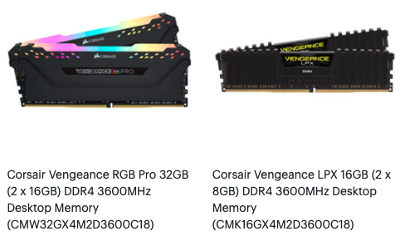

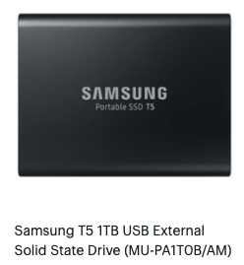

Clarification
Bytes Vs. Bits
  Bytes are represented with a BIG B
    i.e. 4GB, 8GB, 16GB, etc.
  Bits are represented with a small b
    i.e. 150Mbps, 100 Mbps, 1024 Gb, etc.

Slide 12
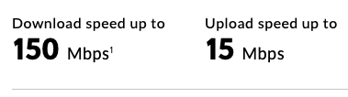
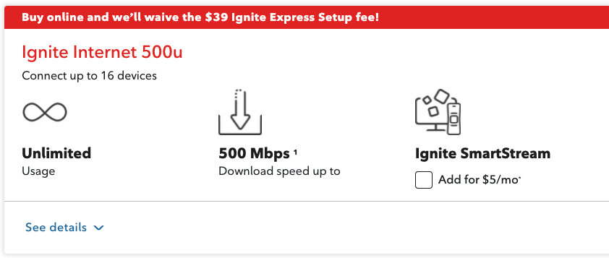
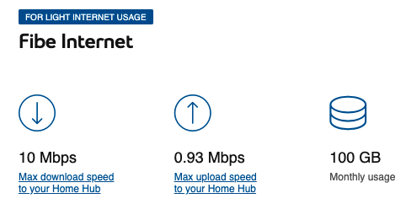
Clarification
Bytes Vs. Bits
  Bytes are represented with a BIG B
    i.e. 4GB, 8GB, 16GB, etc.
  Bits are represented with a small b
    i.e. 150Mbps, 100 Mbps, 1024 Gb, etc.

Slide 13
Review Question #1
Question: From the options given, which memory is the fastest?
Options:
  A) L1 Cache
  B) Solid State Drive
  C) USB Port
  D) Hard Drive
  E) L2 Cache
  F) Registers
  G) None Of The Above
Answer: F

Slide 14
Review Question #2
Question: From the options given, which memory is the slowest?
Options:
  A) L1 Cache
  B) Solid State Drive
  C) RAM
  D) Hard Drive
  E) L2 Cache
  F) Registers
  G) None Of The Above
Answer: D

Slide 15
Review Question #3
Question: The Miss Penalty for L1 cache is:
Options:
  A) AMATL2
  B) HTL2
  C) MPL2
  D) AMATL3
  E) HTL3
  F) MPL3
  G) None Of The Above
Answer: A

Slide 16
Review Question #4
Question: If the CPU requests memory, in which order are the checks made? Assume each check results in a miss.
Options:
  A) L1 » L2 » L3 » HDD » RAM » SSD
  B) L3 » L2 » L1 » RAM » HDD
  C) L1 » L2 » L3 » HDD » RAM
  D) L1 » L2 » L3 » RAM » HDD
  E) L1 » L2 » L3 » SSD » HDD
  F) L3 » L2 » L1 » HDD » RAM
  G) None Of The Above
Answer: D

Slide 17
Review Question #5
Question: Rank the memories from slowest to fastest
Options:
  A) Registers » Cache » RAM » HDD » Magnetic Tape
  B) Cache » Registers » RAM » HDD » Magnetic Tape
  C) Ram » Cache » Registers » HDD » Magnetic Tape
  D) Magnetic Tape « HDD « SSD « RAM « Registers « Cache
  E) Magnetic Tape « HDD « SSD « RAM « Cache « Registers
  F) Magnetic Tape « SSD « HDD « RAM « Cache « Registers
  G) None Of The Above
Answer: E

Slide 18
Questions?
Comments?
Concerns?

Slide 19
Learning
Time
(Straighten Up)

Slide 20

Precursor For Question #1

Slide 21

Precursor For Question #1

Slide 22
Precursor For Question #1
What you just saw are pictures of massive servers
  Servers require lots of hard disks to store information
    Every single tech company uses servers
    The server is the ‘‘cloud’’
All those hard drives connected together is called: RAID
  RAID = Redundant Array of Inexpensive Disks
  RAID = Redundant Array Of Indepedent Disks

Slide 23
What Is RAID?
According to Wikipedia, ‘‘data storage virtualization technology that combines multiple physical disk drive components into one or more logical units for the purposes of data redundancy, performance improvement, or both.’’
  Basically, we combine HDDs (or SSDs) to achieve data redundancy, performance, greater storage, etc.
    Data redundancy: If one drive fails, we can easily recover the lost data from another drive. Since the data is redundant, it isn’t really lost

Slide 24
RAID
There are different kinds of RAID levels
  Raid 0
  Raid 1
  Raid 2
  Raid 3
  Raid 4
  Raid 5
  Raid 6
Each RAID level has its own use
  i.e. Reliability, availability, performance, and capacity.

Slide 25
RAID Recap
RAID stands for Redundant Array Of Inexpensive Disks
  We use RAID to improve things like:
    Reliability, availability, performance, and capacity
In a server farm, reliability and availability are very important
  Why?
    Because servers need 99.9999% uptime. If a drive goes offline or crashes, it needs to be replaced ASAP!

Slide 26
Tutorial Question #1
Question: Mean time between failures (MTBF), mean time to replacement (MTTR), and mean time to failure (MTTF) are useful metrics for evaluating the reliability and availability of a storage resource. Explore these concepts by answering the questions about a device with the following metrics:
  A) Calculate the MTBF for such a device.
  B) Calculate the availability for such a device.
  C) What happens to availability as the MTTR approaches 0? Is this a realistic situation?
  D) What happens to availability as the MTTR gets very high, i.e., a device is difficult to repair? Does this imply the device has low availability?

Slide 27
MTT* Explained
MTTF = Mean Time To Failure
  How long will the drive last before it crashes?
MTTR = Mean Time To Replacement
  How long does it take to replace the drive AFTER it crashes?
    This has to do with copying the data over to the new drive
      More redundancy = Lower replacement time
      Less redundancy = Greater replacement time
MTBF = MTTF + MTTR
  Used to determine availability

Slide 28
Tutorial Answer #1
A) Calculate the MTBF for such a device.
  MTBF = MTTF + MTTR
  MTBF = 3 years + 1 day
  MTBF = 1095 + 1
  MTBF = 1096

Slide 29
Tutorial Answer #1
B) Calculate the availability for such a device
  Availability = (MTTF / MTBF)
  Availability = (1095 / 1096)
  Availability = 0.999087591240876
  Availability = 99.91%
We want availability to be as large as possible
  High availability = Less crashes and less service interruptions

Slide 30
Tutorial Answer #1
C) What happens to availability as the MTTR approaches 0? Is this a realistic situation?
  Availability = (MTTF / MTBF)
  Availability = (MTTF / (MTTF + MTTR))
    If MTTR = 0, Then:
  Availability = (MTTF / (MTTF + 0))
  Availability = 1.0
    Rather, availability approaches 1.0

Slide 31
Tutorial Answer #1
C) Is it possible to have an MTTR to be 0, or nearly 0?
  Not entirely 0, but it is possible to be nearly 0 as drives get more and more inexpensive
    But, replacing file systems and data on a drive can take significant time
      Note: Manufacturers will not include this time in their statistics, even though this time is part of replacing a disk. Similar to how ISPs give the speed in Mbps – they want to make their numbers look marketable

Slide 32
Tutorial Answer #1
D) What happens to availability as the MTTR gets very high? (i.e. The drive is difficult to repair). Does this imply the device has low availability?
  If we look back to the availability equation:
  Availability = (MTTF / (MTTF + MTTR))
  If MTTR increases, and MTTF remains the same, then availability decreases
    Because MTTR dictates how long it takes to repair a broken drive. Repair time eats into availability
  If MTTR and MTTF increase proportionally, then availability is unaffected
    i.e. Samsung’s new SSDs last longer, but repairing them also takes longer

Slide 33
SS

Slide 34
Tutorial Question #2
Question: This exercise examines the single error correcting, double error detecting (SEC/DED) Hamming code.
  What is the minimum number of parity bits required to protect a 128-bit word using the SEC/DED code?
  Consider a SEC code that protects 8 bit words with 4 parity bits. If we read the value 0x375, is there an error? If so, correct the error.

Slide 35
Tutorial Answer #2
What is the minimum number of parity bits required to protect a 128-bit word using the SEC/DED code?
  For SEC, we need to find minimum p such that
  2p > = p + d + 1 (and then add one)
  That gives us p = 8.
  We then need to add one more bit for SEC/DED.

Slide 36
Tutorial Question #2
Question: This exercise examines the single error correcting, double error detecting (SEC/DED) Hamming code.
  Consider a SEC code that protects 8 bit words with 4 parity bits. If we read the value 0x375, is there an error? If so, correct the error.
    Convert 0x375 to binary

Slide 37
THE END

